Slide 1
Surviving Your First Few Months in Niigata
August 10th, 2018 – Ana & Daniel

Slide 2
Life in Niigata can be GREAT!
Great Food
Mountains & Winter Sports
Festivals
Friendly JET Community

Slide 3
BUT… it can also be tough!
Hot Summers
Countryside placement
Driving
First real job
No familiar support system

Slide 4
Niigata’s Hot Summer
And how to cope!

Slide 5
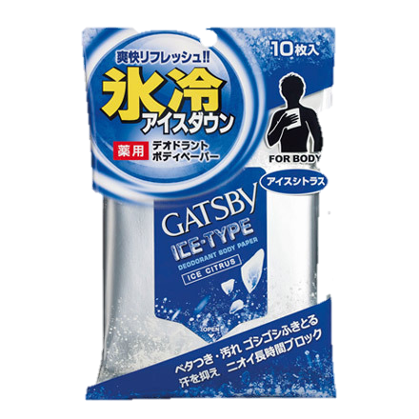
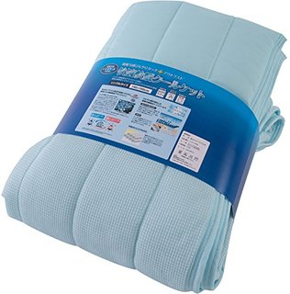
Tips to stay cool
¥3500
¥400
¥1000
SOFT COOL BLANKET
Magical temperature regulating blanket that
will help you sleep cool
GATSBY ICE WIPE
Contains menthol to instantly cool
down over heated bodies.
WATER COOL
TOWEL
Simply soak it in cold water, wring it
out, give a quick "snap," and it’s ready
to drape around your neck.
AC TIMER
Time your AC to turn on when
you arrive home from work.

Slide 6
Other Summer Problems
Culture Shock
Boredom
Driving
Signing Up For Internet/Cell Phone

Slide 7
CULTURE SHOCK
CULTURE
LIFESTYLE
BREAKING
CONTRACT
LANGUAGE
EXPECTATIONS

Slide 8
CULTURE SHOCK
The Solution
Limited and quickly forgotten
Don’t ask “why?”
Do not bottle it up
Talk to fellow:
JETs
Friends
Family back home
Stay active
Contact a PA (Ana and/or Daniel)
Remember that “your” Japan is not all of Japan.

Slide 9
BOREDOM
The Problem
Arrive during Summer Break and Obon
No classes
Little work
Few Responsibilities
Feeling of Uselessness
The Solution
Work will pick up
You’re the new guy
Familiarize yourself with your situation
Be Proactive

Slide 10
DRIVING
The Problem
Having to Drive immediately
Narrow roads
Elderly drivers
“Gaijin traps”
Traffic Light behaviour

Slide 11
DRIVING
The Solution
Drive safe, drive slow
Ask more experienced JETs for advice
Study the road signs
Do NOT use your smartphone while driving

Slide 12
Cell Phone
AU, Docomo or Softbank
AU have an English catalogue
Sim-Only Options
Cheaper, but you need to have or purchase a phone up front

Slide 13
Internet
ASAHI-NET
English Support
Types of Service
Fiber Optic
WiMax (portable)

Slide 14
Autumn
Settling into Life
Understand your work responsibilities
Find your group of friends
Travel around Niigata
Problems
Spreading yourself too thin
Communication Issues

Slide 15
Spreading yourself too thin
NOT AGAIN, PEACH!
The Problem:
Very easy to be active
Parties, hobbies, sports, Japanese classes, travelling, martial arts, enkais, English Club, AJET, etc, etc, etc.
This can lead you to crash and burn out later in the year.
The Solution:
Think before you say yes
Life your life at 70-80% of your normal pace
Take time to recharge
Drop some things

Slide 16
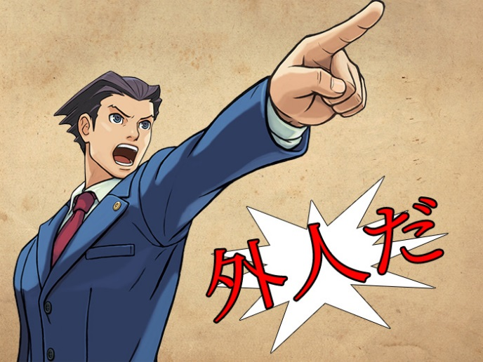
Communication Issues
The Problem:
JTEs do not tell you anything
People have unreasonable expectations
Stuck in your predecessor’s shadow
The Solution:
Teachers have their own work
New workers are often given very little training
Other teachers may be afraid of speaking to you
Try to get comfortable with your supervisor
Use Email to communicate
NO STUPID QUESTIONS
Discuss problems and expectations with your teachers

Slide 17
Other Autumn Tips
Finish setting up your apartment
Happy Home, Happy Life
You will NOT get this done in winter
Get to know teachers at your school
Get close to people in the local community
Get involved with AJET events

Slide 18
Culture Fatigue
HONEYMOON STAGE
FATIGUED STAGE
ADJUSTED STAGE
FATIGUED STAGE

Slide 19
CULTURE FATIGUE
The Solution:
Keep a support group
People with a similar cultural background
Friends and family back home
Take a break
Pick your battles and learn to let things go
You do not have to adapt to Japan in every way
It is probably a temporary feeling
The Problem:
The little stresses of foreign life
Differences in expectations
Differences from home country
Emotionally draining
Stress of daily life
Loss of old identity
Small problems = huge hassles

Slide 20
CONFLICT IN THE WORK PLACE
The Problem:
Still feel like you’re treated poorly
Some teachers seem to dislike working with you
No communication, don’t feel trusted
The Solution:
Remember:
Different work cultures
Some people will just not like you
Some people are just “buttheads”
Are you overstepping your bounds?
You will not revolutionize English teaching in Japan
Japan = high context society
Address problems when they are small
Help your Japanese coworkers understand your feelings

Slide 21
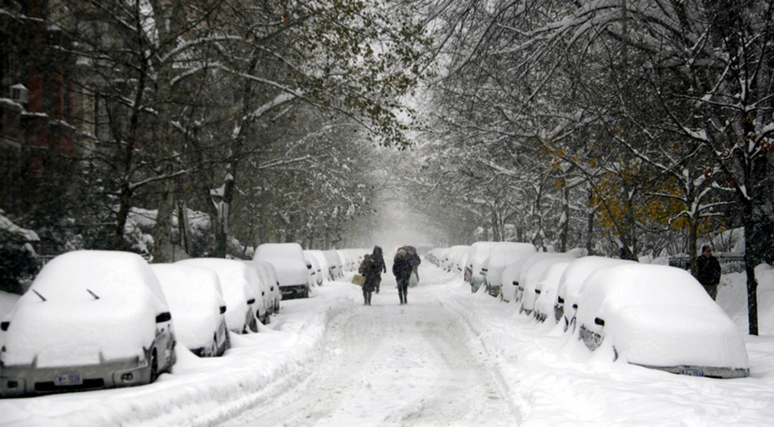
WINTER!
Life in Japan becomes normal
Every day is no longer an adventure
Get good at your job
Problems:
Culture fatigue
Conflict in the workplace
The snow

Slide 22
Snow and the Cold
さむいですね！
The Problems
Niigata has the heaviest snowfall in Japan
Poorly insulated apartments
Little to no sunlight
The Solutions
Winter-proof your apartment
Enjoy the snow
Keep warm

Slide 23
OTHER WINTER TIPS/INFO
Stay Active
It’s very easy to hermit during the winter
Buy things online
Amazon
Rakuten
Are you re-contracting?
Deadline is in January
Many contracting organizations will want to know earlier
Preliminary decision in October/November

Slide 24
WHAT DOES YOUR SUPPORT SYSTEM LOOK LIKE?
JET PROGAMME
PARTICIPANTS
Contracting
Organizations
Prefectural
Advisors
Regional Advisors

Slide 25
FIRST LEVEL: CONTRACTING ORGANIZATION
Contracting Organization
Management
Supervisor
Co-workers
First stop for school, work, and housing related information, issues, and questions.
Know your specific situation and contract.
Remember:
Maintain a good working relationship
Maintain communication and work together
If unable to build a good relationship with your supervisor…
Find another co-worker who can help
Your supervisor:
May be new
May make mistakes
May be busy
May also be useless/non-existent

Slide 26
FIRST LEVEL: CONTRACTING ORGANIZATION
JETs are expected to go to their supervisor and CO first with questions and problems.
Talk to your CO before contacting a PA
Talk to your CO to contact CLAIR
Apply to your CO for Counseling Subsidy (50% or up to 20,000 yen)
CLAIR is working to strengthen training and support for COs

Slide 27
SECOND LEVEL: PREFECTURAL ADVISORS
3 PAs in Niigata Prefecture
CIR PA = Ana Puente
ALT PA = Daniel Taylor-Protopapa
Japanese PA (JPA)
Important because:
Have access to lots of information and resources
Experience with Japanese offices (and schools*)
Can contact CLAIR
Required to maintain confidentiality
Remember:
May not necessarily agree with you

Slide 28
PREFECTURAL ADVISORS...
1
Act as a confidential consultants for JETs with serious issues
2
Distribute vital information via email (PLEASE CHECK YOUR EMAIL REGULARLY)
3
Work with relevant groups to hold annual work events (e.g. orientations)
4
Contact RAs to confirm safety of all JETS after a natural disaster

Slide 29
HOWEVER...
PAs do not know everything
We may make mistakes.
We’ll always try to help and be there for you, but being PA is in addition to our other work. We get busy too. Please be patient.
We are available during our regular work hours.
Please contact us outside of these work hours only for EMERGENCIES.
Please use e-mail to contact us. Phone is acceptable as well but is best scheduled ahead of time.
We do not hold any authority over you and are not your bosses.
No, we cannot get you:
A transfer
A raise
Your nenkyu information
A new apartment

Slide 30
AND REMEMBER...
The following may and will usually have your answers!
General Information Handbook
The online Niigata Welcome Pack
Ajetniigata.com
Google
Please read them thoroughly. It won’t make your vision any worse.

Slide 31
ADDITIONAL LEVEL: REGIONAL ADVISORS
JET volunteers who help out others in their respective areas.
Important because:
Welcome new JETs and try to help them acclimate
May have experienced the exact same problems new JETs will
Answer questions and provide information about daily life in the region
Help JETs get the help they need when they cannot handle the issue personally
Contact JETs to confirm their safety after a natural disaster or other emergency event has taken place and report the results to the PAs
Remember:
The RA position is a volunteer position
Not for serious work or personal problems

Slide 32
ADDITIONAL SOURCES OF SUPPORT
Counseling provided by CLAIR
JET Mental Health Counseling Assistance Program
JET Online Counseling Service (Free)
Web mail
Skype
Other
Tokyo English Life Line (TELL)
03-5774-0992
9:00-11:00pm
Telljo.com

Slide 33
BREAKING CONTRACT
If you are considering breaking contract, PLEASE contact a PA
Situations can often be resolved with mediation
If you don’t tell us, we may not find out until too late
Breaking contract is often a huge financial burden
Think carefully about recontracting
Fairly common
On average, 2.09 % of all JETs
Niigata:
2017-2018: 3 JETs
2016-2017: 4 JETs
2015-2016: 2 JETs
2014-2015: 2 JETs
Many reasons:
Employment, Education, or family matters: 50%
Personal Reasons: 50%

Slide 34
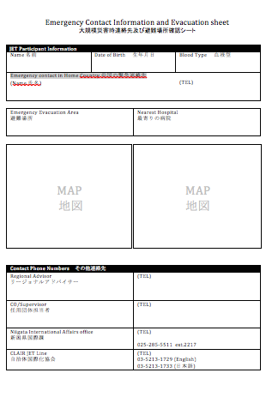
OTHER INFO
Disaster preparedness and evacuation areas
Will be discussed during this afternoon’s regional meeting.
Make sure you know who your RA is

Slide 35
THANK YOU
QUESTIONS?

