Slide 1
A Gentleman’s Guide to Life in Japan

Slide 2
Today’s Topics
Professionalism
Relationships
Men’s Issues

Slide 3
Professionalism

Slide 4
Appearance
Dress well to start, then relax as the year progresses
Button-down/polo and Khakis/Chinos nearly always work
Keep a dress shirt and tie in your locker
Facial hair
Two options
Clean Shaven
Structured facial hair
If you are going to shave, keep at it.
If you have facial hair, keep it clean.
Shower, wash, and use deodorant
Japanese deodorant is fairly weak
Western deodorant is available on Amazon and Rakuten

Slide 5
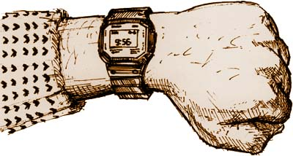
Professionalism
Get to work on time!
Be productive at your desk
Three levels of work productivity
Work-related: Lesson planning, creating materials
Life-related: Studying Japanese, familiarizing yourself with the school
Inappropriate: Watching movies, playing video games
Take note of coworkers comments
They may rarely be direct, but they are trying to tell you something
Ex: “It must be nice to be able to wear what you want,”
“That book you’re reading looks really interesting!”
Try to communicate with coworkers
They may not realize how little you know
Find or make schedules and plans for the week

Slide 6
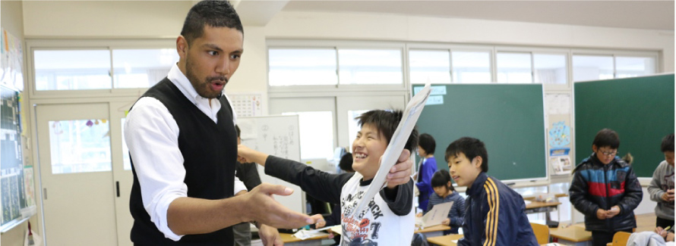
Professionalism
Do not complain to your student or other teachers
If you have problems, bring them up with your supervisor
Later, you may be able to talk honestly with other teachers
You are new to this job and the system will not change just for you
You are a role model for your students, and a representative for all foreign men
What you say to your coworkers and students will affect how they see all of us

Slide 7
Etiquette
When you get to the teachers office, greet everyone with “Ohayou Gozaimasu!”
When you leave, say “Osaki ni shitsurei shimasu.”
Be polite and cheerful
Yawning and sleeping on the job
Make sure you are getting enough sleep
Being tired sometimes is natural, being exhausted every day is not
If you are exhausted every day, try to find the reason
Never, ever, ever sleep on the job

Slide 8
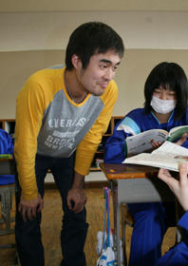
Students
Relationships with students
Much closer than in many other countries
Both physically and emotionally
You will likely be touched, clung to, confessed to, and poked in the butt
Boundaries must still be maintained
Outside of school, do not go anywhere private alone with them
Especially true of male teachers and female students
Discipline:
You have as much power as the JTEs and the kids give you
Above all, they are your students
Not your friends
Not your confidants
NOT POTENTIAL DATES

Slide 9
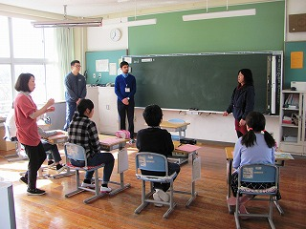
Other teachers
Relationships with other teachers
Will depend on your situation
Teachers may be dying to talk to you, or they may not care at all
Try to socialize and get to know them
Your teachers will be able to help you better if you are already friends
Be proactive if necessary
Ask teachers about events, clubs, town information
You will be judged differently than Japanese workers
Ex: If Yamada-sensei barfs in a toilet, everyone forgets the next day. If you barf in a toilet, you become a legend.
Even at a party, Japan is still Japan, and your boss is still your boss
Remember, you may not get along with some of your teachers!

Slide 10
Your Supervisor
Be careful with your expectations for your supervisor
Supervisors will come in all shapes and sizes
Helpful, disdainful, very competent, incompetent, interested in your life, not available at all, etc.
Try to establish what kind of relationship you can expect early on
If you do not get along with your supervisor:
Try to become more independent from them
Turn to other teachers or friends for advice and help on issues
Remember that your supervisor may change in April
If necessary, try to discuss things with them after school
Talk to older JETs or your PA

Slide 11
SNS, Blogs, and YouTube
TONS of SNS-worthy experiences
However, keep others’ privacy in mind
Students, teachers, other ALT’s
Schools may not be thrilled to see posted pictures of students
Get permission before using someone’s name or likeness
Show respect when including someone in a video.

Slide 12
Men’s Issues

Slide 13
Daily Life
Clothes
Other items
Who has trouble?
Men over 180cm and 90kg
Over size 10 feet (29cm+)
Chain stores
Uniqlo, G.U., Aoki
Recycle shops
Off House, Second Street
Online shopping
www.rakuten.co.jp
www.amazon.com
www.zozotown.com/en
Furniture
Nitori, Off House, AEON
Finish setting up your apartment in summer or autumn
Groceries
Harashin, Cupid, Uoroku, Charenjya
Ask RAs and other JETs
Learn to cook for yourself!

Slide 14
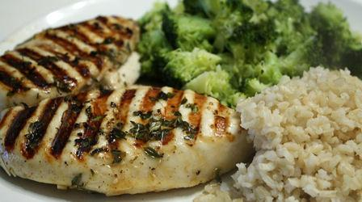
Super Easy Dinner Recipe
Ingredients
One chicken breast
One head of broccoli
Instant rice
Directions
Put the chicken in a toaster oven, set for 10~15 or until cooked
Cut broccoli into bite-sized pieces, put in a bowl, add water, cover said bowl, and microwave for 3 to 4 minutes
After the broccoli is done, open the instant rice, put it in the microwave and cook for 1 and half to 2 minutes
Take the chicken out of the toaster oven, serve everything, and enjoy.

Slide 15
Health
Diet
Cooking and a balanced diet
Backup easy meals
Sleep schedule
Try to find a set time to get to sleep every day
Sun rises very early in Japan
Sleep masks
If you are yawning at work, you need to sleep more
Exercise
Find something to stay healthy and active
Especially in winter
Most towns have a gym, and many teachers play in a sports league
Many opportunities with other JETs
Niigata runners, Basketball, Soccer, Skiing, Swimming
JET exercise/health groups

Slide 16
Bullying
“Gaijin” Bullying
Your opinions and feelings can often be ignored or looked over
“The Dancing Bear”
“Americans are all fat” “Australians are criminals”
Microaggressions
Body Image
“Skinny is best”
Comments on skin color, eye color, weight gain, size of nose, size of penis, etc.
Alcohol Bullying
As a foreign guy, people will think you can drink a lot
“An empty glass is a glass waiting to be filled”

Slide 17
Negative attention
You attract a lot of attention
Mostly positive
Negative attention includes
Jeering, name-calling
Standoffish behavior
Inappropriate touching
Be the bigger man
Avoid fights at all costs
Dangerous Situations
Call or notify the police immediately
Do not rush to get involved yourself

Slide 18
Sexual Harassment
From women:
Male JETs have been sexually harassed and assaulted by women
The man is expected to never say “no”
Be aware of potentially dangerous situations
From other men:
Frank talk about your genitals, sexual history, sexual preferences, etc.
Japanese men can be very physical and touchy, especially at parties
If you feel uncomfortable/threatened, act on it
You do not have to put up with it, and you are not at fault
Ask the aggressor to stop, tell your PA, get other teachers to help, etc.
From students:
Your students may be touchy with you and may try to grab your penis, “kancho” you, or rub your legs, arms, or other parts of your body
If you are uncomfortable, tell your students to stop, and if persists, tell your supervisor

Slide 19
Mental Health
Mental Health issues
Depression (Pre-existing, seasonal, relationship-related, etc)
Homesickness
Eating Disorders
Bipolar
Extensive support system in place for help.
AJET Peer Group Hotline: 050-5534-5566
Prefectural Advisors (PA’s) and Regional Advisors (RA’s)
Use of these resources is a sign of strength.
Stay in touch with family and friends
Know when to take a break

Slide 20
Relationships

Slide 21
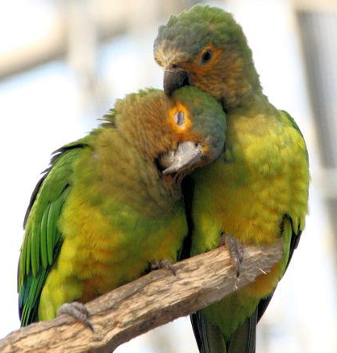
Relationships
No assumptions
Relationships are very normal on JET
You will not automatically become a playboy
Always be safe
Small towns create big rumors
People will see who you come home with
The rumors are not necessarily based in reality

Slide 22
Relationships with Other JETs
Very common part of the JET experience
Can heavily affect the JET community
The JET community is like a large group of friends
A bad break-up or fight can change the dynamics of a group of JETs in smaller areas
Your drama will become other JETs’ drama
Above everything, act like an adult
Rumors and secrets spread fast in the JET community
If you treat another JET poorly, people will know
You will definitely see this person again
Reputations made, even early on, can stick with you

Slide 23
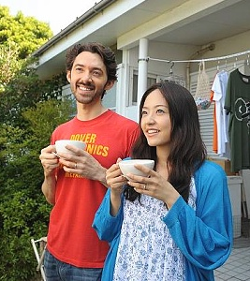
Relationships with Japanese Women
Japanese women are not easy
Conservative dating culture
Pace of progression in a relationship will vary.
Learn the signs
When in doubt, be direct
Different cultures, different signals
No response = Not interested
Persistence does not guarantee success.
Don’t let persistence become harassment.
Practice safe sex
JETs have gotten girls pregnant before
JETs have gotten STDs before
Condom use is not as common in Japan

Slide 24
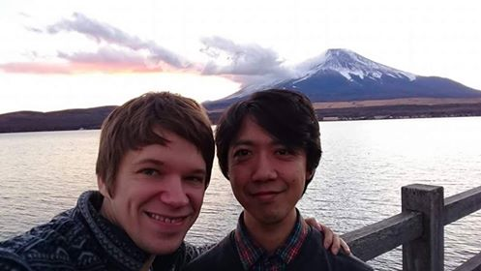
Relationships with Japanese Men
Conservative dating culture
Japanese men tend to be closeted
Some guys might be reluctant to share personal info on first few dates
If you meet the family, you may be introduced and treated as a friend
Meeting men
Living in the countryside typically means long distance relationships
LGBT bars/nightclubs only tend to be found in larger cities
There is an online dating community in Japan
Practice safe sex
HIV awareness is low and infections are more common than other countries.
Hepatitis B and syphilis have recently seen rises among younger people
Other issues
Same-sex marriage is not recognized
Same-sex couples cannot adopt
No national laws protect LGBT rights
*This is only one man’s experience: Theodore “Theo” Brown

Slide 25
Homosexuality in Japan
Homosexuality is generally socially accepted in Japan, but often misunderstood
Outright hatred or violence is very rare
However, ignorance is quite common
You may be treated as the butt of jokes at times
Rarely spoken about
People may feel uncomfortable if you are very open
You may be asked to hide it from students and the community
October 2012 edition of the “AJET Connect” magazine
Will depend on your school and situation
Never out another person
Not as apparent to Japanese people
Stonewall AJET group
http://stonewall.ajet.net/

Slide 26
Safe Sex in Japan
Condoms
Available at convenience stores and pharmacies
If you want western condoms, buy online or get shipped from home
Amazon and Rakuten have western condoms
Some larger stores may have them as well (Ex: Don Quixote)
Some Japanese condoms come un-lubricated
THEY ARE ALMOST ALWAYS BIG ENOUGH
Birth control
Available and commonly used, but slightly less widespread than some western countries
Morning after pill
Requires a prescription
Only available at certain locations in Niigata
See “A Guide to Birth Control Pills in Japan” at www.survivingnjapan.com

Slide 27
STDs in Japan
JETs have caught STDs
Chlamydia, Gonorrhea, and AIDS
You will not be dismissed from the JET program
Whether you tell your school or not is your choice
Testing available in Niigata City
The Ueno Clinic is anonymous, next to Niigata Station, quick, and fairly cheap.
www.ueno.co.jp
Testing ranges from 12,000 to 22,000
Japan Healthcare Info offers STD testing by mail in English
Results are returned via email from http://japanhealthinfo.com
Testing may be available in your area as well （性病科 - Seibyōka）
Doctor patient confidentiality less strict in Japan
If you get tested in your town, your BOE, school, friends, and coworkers may find out

Slide 28
GO FORTH YOUNG GENTLEMEN

