Slide 1
High School
Self-Introduction Lessons
Presented by Angela Moore

Slide 2
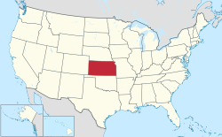
A Bit About Me…
Angela
3rd Year ALT
Lived in Tokyo for one year for study abroad
Originally from USA
Currently lives in Niitsu
Teaches at Niitsu, Niitsu Kogyo, Niitsu Minami, and Shirone High Schools

Slide 3
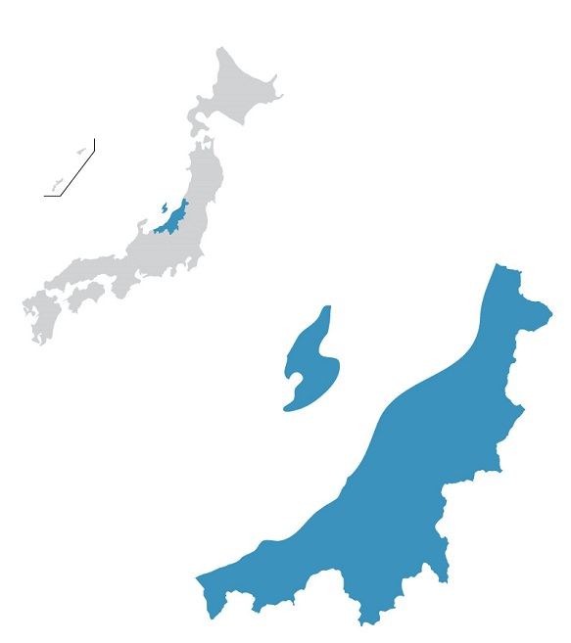
JAPAN
NIIGATA PREFECTURE
Niigata City

Slide 4
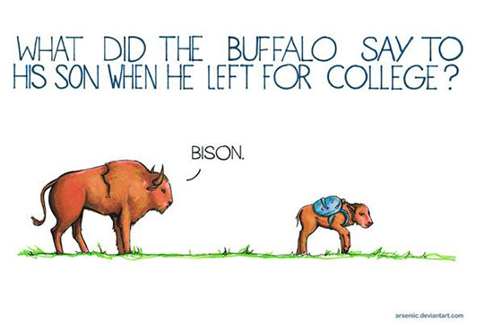
Let’s get to know each other...

Slide 5
Overview
Today we will talk about...
PRIMARY OBJECTIVES—what are your main goals when giving a self-introduction lesson?
CONSIDERATIONS—what other things do you need to consider when planning your lesson?
EXAMPLES—what have we done in our self-introduction classes?
SUMMARY—Dos and Don’ts for your self-introduction lesson
QUESTIONS

Slide 6
Primary Objectives
?

Slide 7
Primary Objectives
OBVIOUS? Teach the students about you and your country, right?
Make a good first impression.
Set up your expectations of the students for your lessons.
Involve the students in the lesson.
Determine the language and confidence level of your students.
Start building a good relationship with your JTE.
Make English fresh, exciting and fun!

Slide 8
Prioritized Primary Objectives
Start building a good relationship with your JTE.
BEFORE the lesson
1. Make a good first impression.
Future classes will be WAY easier.
2. Involve the students in the lesson.
Get them USING English.
3. Make English fresh, exciting and fun!
Get 1 & 2 right and 3 & 4 will happen.
4. Set up your expectations of the students for your lessons.
5. Determine the language and confidence level of your students.
6. Teach the students about you and your country.
VERY helpful for future lesson planning

Slide 10
Other Things To Consider
The JTE may have too high or too low expectations of the class—
be prepared to adapt!
There will be a range of language abilities in your class.
Make your activities flexible if you can!
Students may not understand your accent at first, and you may not understand theirs!
Speak very SLOWLY and CLEARLY.
High language level does not equal high confidence level, and vice versa.
This is FRUSTRATING, but ganbare!

Slide 11
Bomb Game

Slide 12
For The Next Activity…
Make teams of about 4-5
Each team has 500 points
Wager your points on an answer!
(This is your team for the rest of the session, volunteers can win points for their groups.)

Slide 13
What state is Angela from?
California
Kansas
Nevada
Notes:
Angela

Slide 14
How long has Angela been in Japan?
2 year
4 years
3 years

Slide 15
Introducing Kansas…
It’s not just a lecture!
I show them videos, use lots of pictures, animated slides etc.
I compare Kansas to Japan:
Makes new information relatable.
Covers a range of topics to cater to different interests.
You can fire questions at the class to get them participating.
(What do you call X in Japanese, What do you call X in English, What X is Niigata famous for? Remember, every volunteer wins points!)

Slide 16
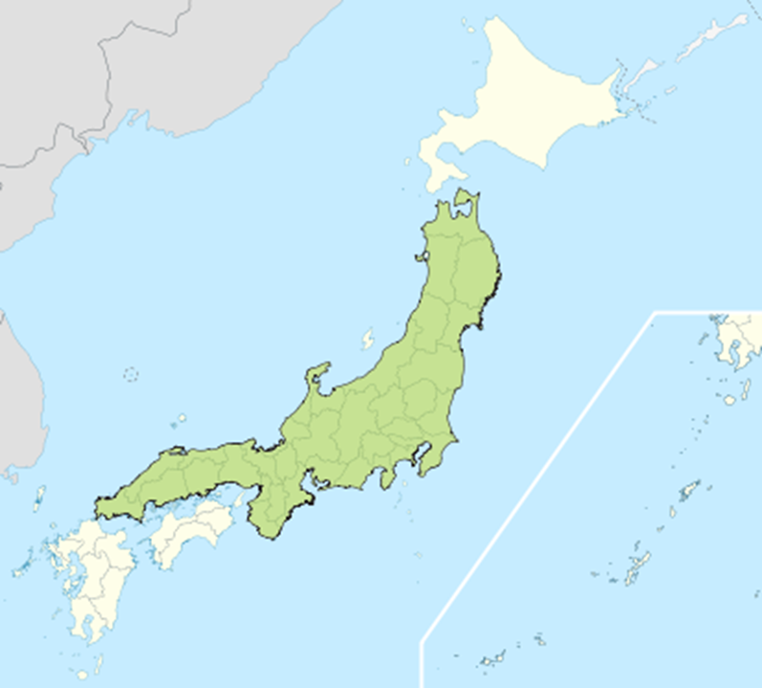
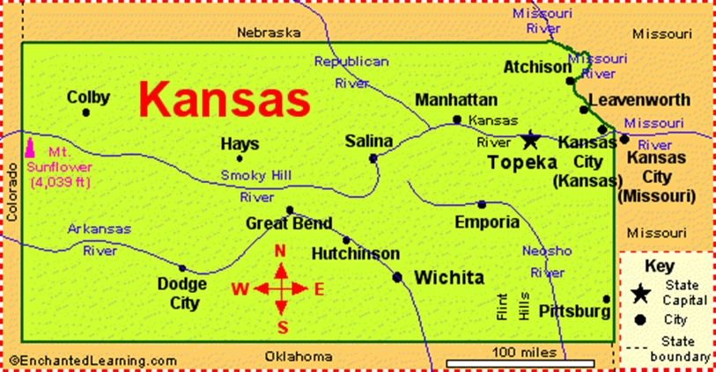
Where is Kansas?
Kansas Population is 3,000,000 people = Niigata prefecture
How big is Kansas?

Slide 17
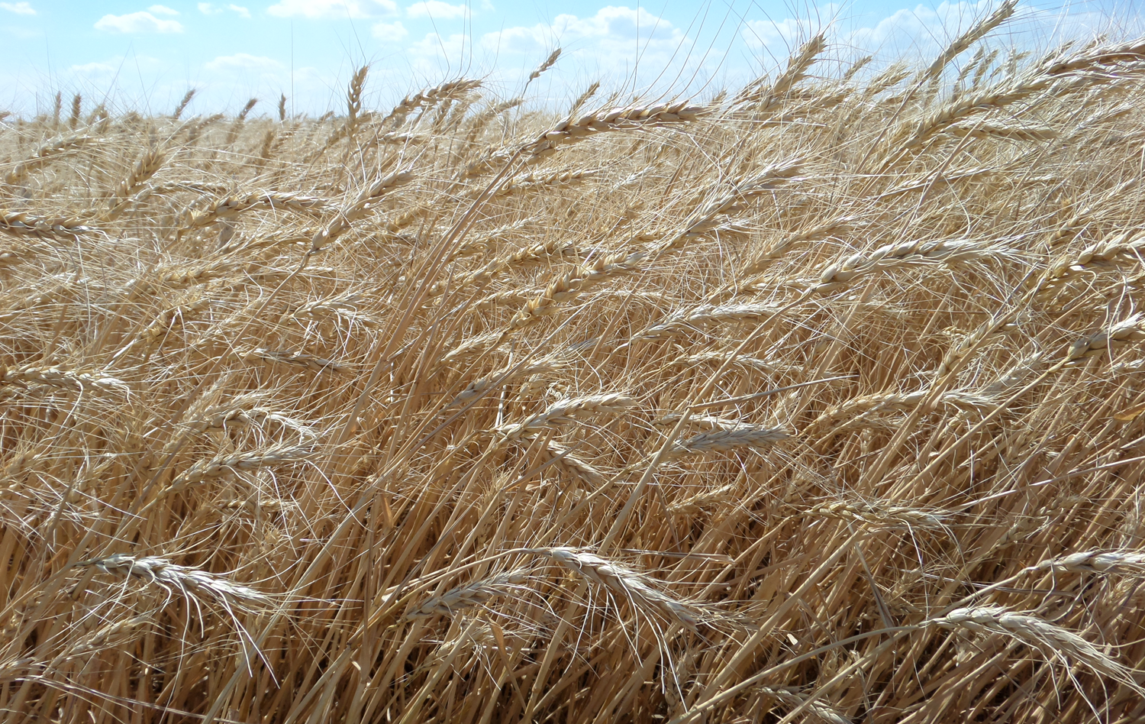
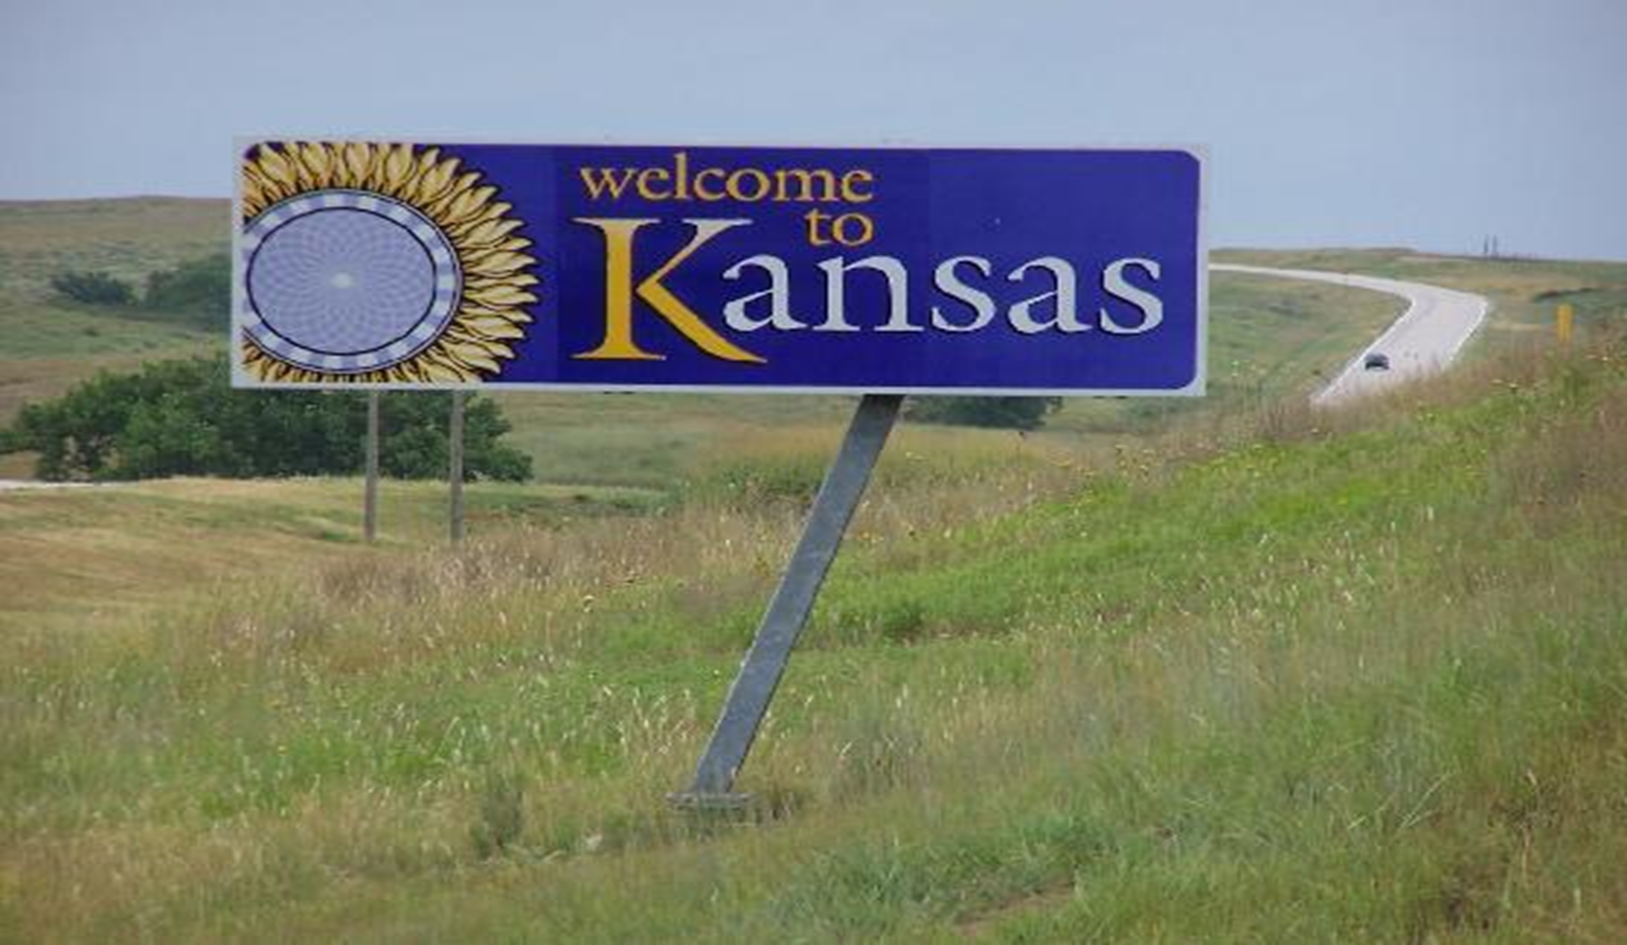
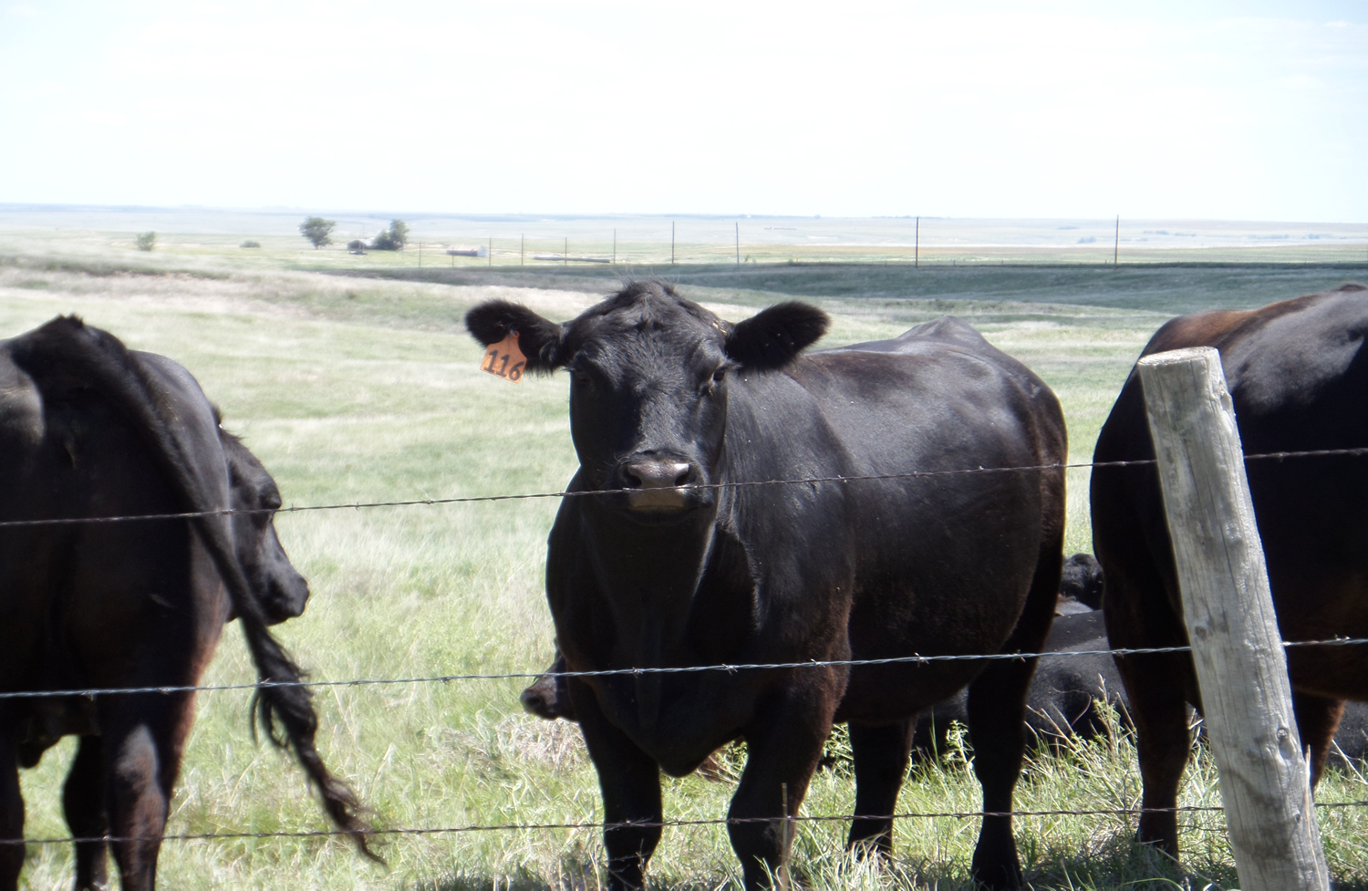
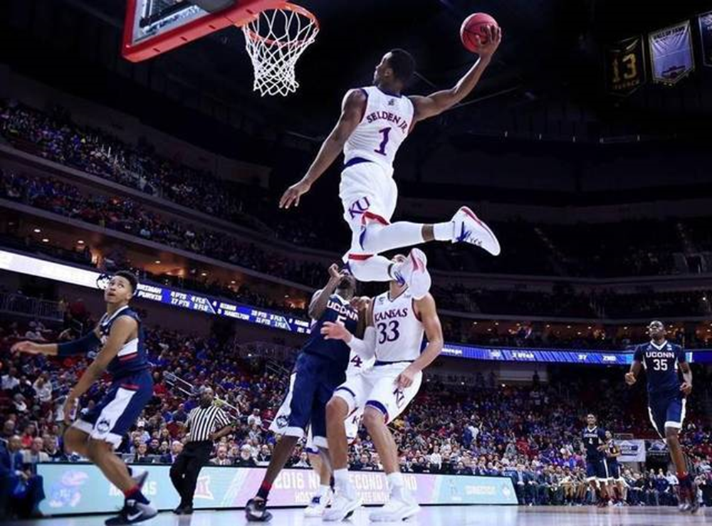
What is Kansas like?

Slide 18
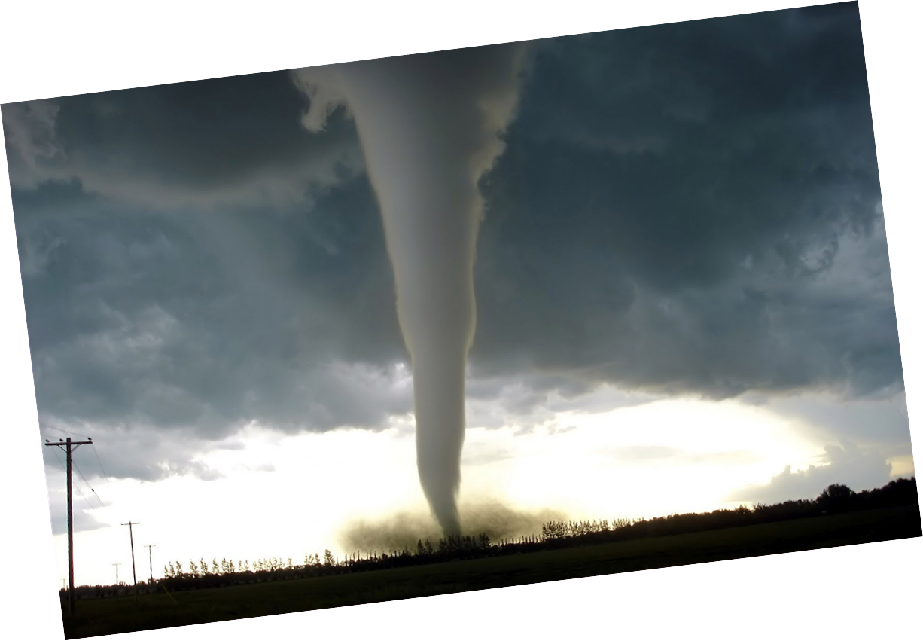
What is this?

Slide 19
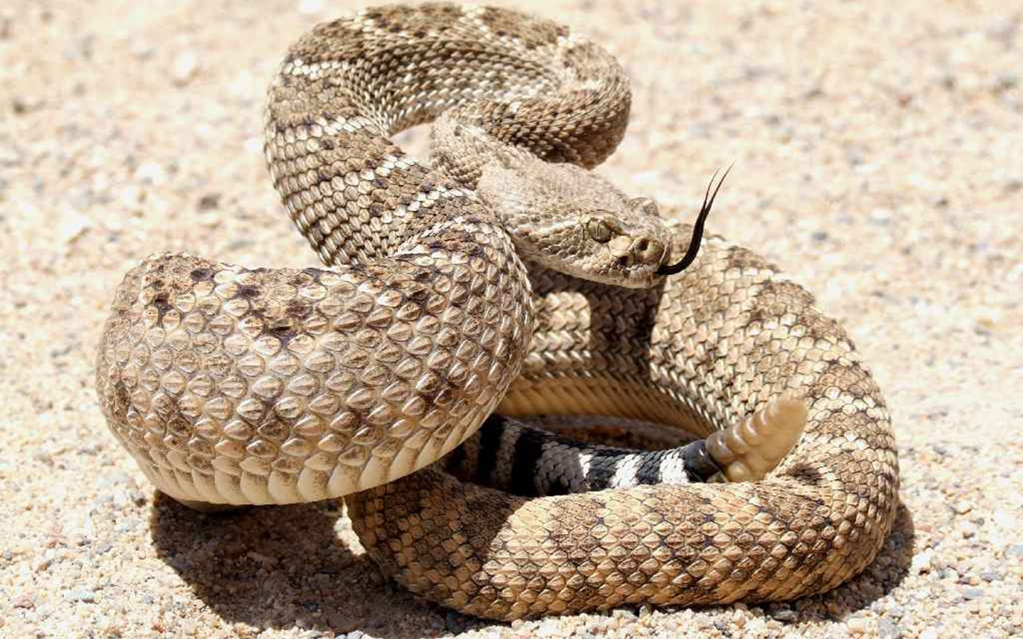
Hiss…

Slide 20
Bomb Game The game you just played
This game is great because:
ALL STUDENTS have to participate!
They all have to:
Listen to each other.
Come up with an original idea (or help each other).
Speak English!
It’s flexible for language level and confidence.
It gets students moving…and they are excited to hold the pokeball.
Notes:
JENNY

Slide 21
Maru /Batsu True or False questions (about me).
This game is great because:
The instructions are simple.
You can make the students move around the classroom to vote.
They learn about you through a game instead of a lecture.
You can make questions harder and harder, but the element of chance means even low language level students can still win.
You can blow their minds with weird facts about yourself and leave a good impression!
Notes:
JENNY

Slide 22
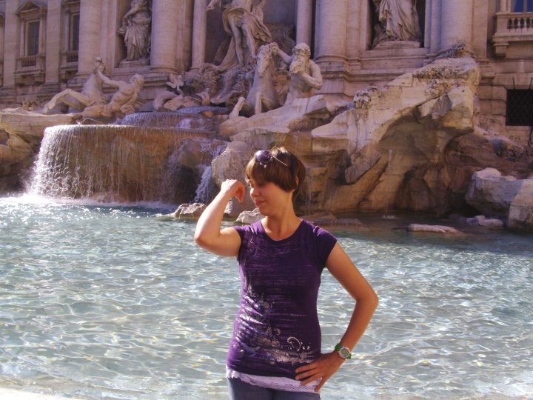
I have been to Italy

Slide 23
I have one brother and one sister.

Slide 24
Questions? Leave time for this! (And use to fill in extra time)
Gives one last opportunity for students to use English creatively and communicatively.
Can be a speaking and/or writing exercise.
(Self-Introduction of Students)
Very flexible activity!
Notes:
JENNY

Slide 25
Summary
DOs and
DON’Ts

Slide 26
Dos and Don’ts
Do
Don’t
Make English EXCITING! Or at least interesting…
Give a lecture.
Expect too much right away.
Encourage students to speak and give their ideas/opinions.
Focus on just one topic or just one skill.
Get students involved in the lesson as much as possible.
Be respectful of Japanese culture.
Make your lesson all about you (topic or approach).
Notes:
SEAN

Slide 27
Dos and Don’ts
Do
Don’t
Be flexible and creative.
Try to do too much in one lesson (things take longer than you think!)
Listen to and always check your ideas with your JTE!
Be disappointed if your JTE doesn’t like your ideas.
Be patient AND proactive.
Don’t give up!
Make a good first impression on your students if you can.
Don’t worry! You got this.
Notes:
JENNY

Slide 28
Otsukaresama (That’s all for today, great job!)
Questions?

