Slide 1
JHS/ES Lesson-Planning and Team Teaching
Kyle Sponenberg

Slide 2
Part 1: Lesson Planning

Slide 3
4 Steps to Effective Lesson Planning in JHS
Step 1: Find out when you have class
Step 2: Find out what you’ll cover
Step 3: Create the lesson plan
Step 4: Iterate and improve

Slide 4
Step 1: Find out when you have class
Your JTEs WILL be busy. It’s your job to find a time to discuss lessons with them
Also make sure to make yourself available
Get a schedule well in advance. No one likes being surprised
Schools make weekly schedules. Having one can be very helpful
The schedule WILL change. Sometimes you just have to go with it

Slide 5
Step 2: Find Out What to Cover
Lesson types
Grammar points
Reading practice
Listening practice
Conversation practice
Cultural lesson
Review
Ask if the students have learned the material yet
See if your JTE has suggestions or something specific in mind that they want to do

Slide 6
Step 3: Create the Lesson Plan
Things to consider when planning:
Class length
45 vs 50 min
Activity time/lesson schedule
Warm up activities
Transitions
Directions
Materials
Activity types
JTE’s role
What period is the class
Class attitude
Class/activity goals

Slide 7
Step 4: Iterate and Improve
Reflect on your lessons once you've finished
What worked and what didn't?
How did the class react?
What does your JTE think about it?
Use your self-introduction lesson as a testing ground.
Make concrete changes- even if they're small
Keep notes on all of your classes to help plan in the future.
Iterate on lesson planning itself.

Slide 8
Lesson Plan Skeleton
Greetings
Warm-up
Main Activity 1
Main Activity 2 (if necessary)
Closing
Notes:
Review can be fitted into the lesson at any stage, either as a warm-up, or right before an activity or game

Slide 9
Greetings
Hello/Good morning/Good afternoon!
How are you? I’m ~
What day is today? It’s ~
How is the weather?
Classes usually have a set greeting in place
Notes:
There’s a common phenomenon when you first try to implement this. For example, you ask the class “How are you?” and you get a very confident “How are you?” reiterated back to you. So you show them that it’s a question-answer situation. How are you? I’m fine, etc. Same with asking the day of the week, and the weather. In the beginning when you’re just establishing a routine, especially with 5th graders, it’s very helpful to implement gestures and pair your greetings with flashcards. Eg. I’ll ask “What day is today?” and hold up a flashcard that says Wednesday, and the Japanese equivalent, suiyoubi.
This is also a great time to throw in questions you taught them last lesson. For example, pick a student number/name and ask them “Do you like oranges?” Pick a couple more students. And by this point you’ve shifted into a sort of warm-up.

Slide 10
Warm-up
Short activity
Preferably one that reviews previous material or grammar points
Depending on the class start with something either active or passive
Notes:
Where you’re reviewing things you’ve taught or just things you taught last lesson, OR doing a small game
These two categories apply to main activities, not just warm-ups. So what do I mean by active…

Slide 11
Active Warm-ups
Target: Dull, sleepy, sluggish-looking class
Examples
Moving around the classroom
Interview
Games
Notes:
Activities that require them to move around the class, get their limbs moving and move their muscles. Games that increases the energy of the class and are typically ''rowdier''. For example, pac-man, mario karts, criss-cross, pictionary relay, etc. Group competition or activity can also be applicable, but keep in mind some classes will respond differently and a sluggish-looking class might remain just as sluggish through a supposedly energizing activity, while another sluggish-looking class might brighten up from the same activity
On the other hand, sometimes they love the warm-up game so much, that you end up doing that game for the whole lesson

Slide 12
Passive Warm-ups
Target: overactive, rowdy class
Examples
listening (in textbook)
drawing
writing (practice writing the alphabet)
desk-work
Notes:
I give my students tracing paper and we trace through A-Z slowly, doing a few alphabets at a time.
You can even do this at the end. I use this at the end so while they're writing, I have ample time to give out stickers to students who raised their hand and presented in class (if you have good memory. If you have bad memory, you can consider giving them out as you ask them questions. I just prefer doing it at the end so it doesn't take up time during an activity) and give out stamps in their passports

Slide 13
Main Activity
Lesson focus
Should involve key grammar point or vocabulary
1-2 main activities per lesson depending on class size, level, and speed

Slide 14
Closing
Leave a few minutes for students to write review sheets, collect papers, turn in workbooks or homework, etc.
Give out stickers or stamps, congratulate winners, etc.
Goodbye

Slide 15
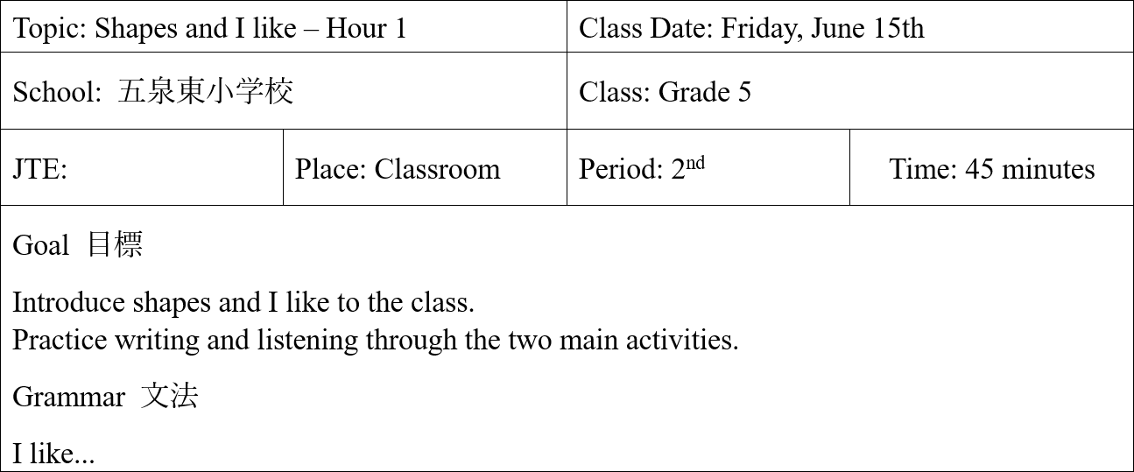
Lesson Plan Example
Notes:
If you have multiple schools, I highly suggest making an excel doc keeping track of each class progress and what to do next class
Topic = Which lesson of the book are you doing? What’s the theme? Helps you keep track of how many hours of a particular lesson you have done
Goal = What would you like to get done in this lesson? For me, I wanted to give the students some time to decorate their passport booklet and, if time allowed, make nametags. I was also aiming to introduce some basic, key English phrases that will be repeated and used to maintain order and manage activities during English lessons. Moreover, I wanted to start the Hi Friends curriculum
Grammar = And for that day’s lesson I’ve narrowed the main grammar point down to these three phrases
This section is like brainstorming. Once you have it written down, you can better build activities and games around the main grammar point of the day, and have an idea what you can omit and what you should prioritize if time is running short.
You will be getting used to the pace and level of each of your classes. So you may find yourself running short on time or with a lot of extra time. Knowing what you want to accomplish (goals) and the students to take home that day helps you decide how to improvise with time. And later we’ll talk about filler games, which are games you could throw in as a buffer in between activites or during extra time.

Slide 16
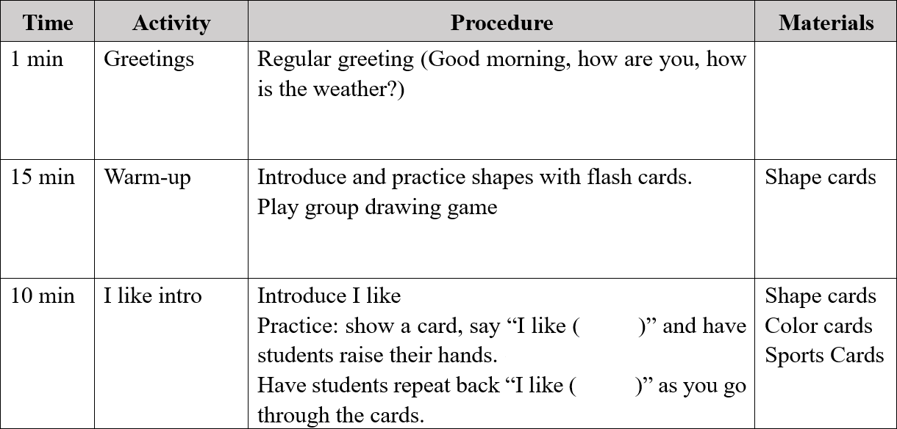
Lesson Plan Example Cont‘d
Notes:
Here, the nitchoku will start each class with a greeting. You can utilize that and teach them how to do it in English. Might be difficult and slow at first but they get the hang of it really quickly.
Then here you see I’ve jumped to one of the main activities of the day, which is to teach them some classroom English
Timing is rough. Something might run longer or shorter than you expected. And you get better as estimating overtime.

Slide 17
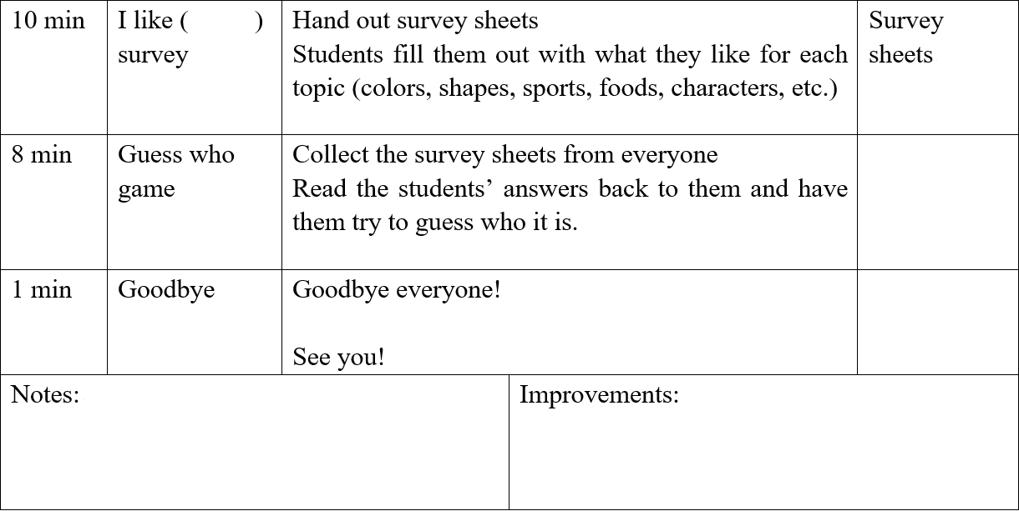
Lesson Plan Example Cont‘d

Slide 18
Learning Stages
Vocabulary
Simple grammar
Question- Answer
Notes:
At younger grades 1-3, you might stop at introducing simple grammar or question-answer form
Some classes might need to spend more time on one stage than another. There's a trend for students here to absorb and remember a lot of words - you'll be surprised at their vocabular bank. However that amazing absorption weakens when it becomes a longer sentence, and question-answer form. This is because they have to remember most of what they are taught BY THEIR EARS. Reading and writing the alphabets don't happen until junior high school. With no visual to associate sounds with and rely on, it becomes a memory test. And the more they practice, they more they are likely to remember it. For example, I say ''See you next time'' everytime I end a class. They pick it up right away because I say it so many times. This is true for learning any languages - you pick up the things you hear repeatedly. Similarly, the more you go over grammar points, the more comfortable they get

Slide 19
Example: Shapes and I like
I like stars.
Do you like stars?
Yes, I do.
No, I don’t.
What shape do you like?
Notes:
At younger grades 1-3, you might stop at introducing simple grammar or question-answer form
Some classes might need to spend more time on one stage than another. There's a trend for students here to absorb and remember a lot of words - you'll be surprised at their vocabular bank. However that amazing absorption weakens when it becomes a longer sentence, and question-answer form. This is because they have to remember most of what they are taught BY THEIR EARS. Reading and writing the alphabets don't happen until junior high school. With no visual to associate sounds with and rely on, it becomes a memory test. And the more they practice, they more they are likely to remember it. For example, I say ''See you next time'' everytime I end a class. They pick it up right away because I say it so many times. This is true for learning any languages - you pick up the things you hear repeatedly. Similarly, the more you go over grammar points, the more comfortable they get

Slide 20
Other things to consider when lesson planning

Slide 21
Students’ comfort level
Students use English more easily in some situations over others
Group
Pair
Individual
Notes:
Everyone is comfortable on different levels, sometimes all, sometimes only one.
Most students are most comfortable at group-work, where attention is spread across multiple people. Shyer students might prefer this setting the most. If you are doing a game that involves groups competing against one another, and each person in the group rotates to give an answer, then it exerts more pressure than simple group games and kind of becomes individual performance.
Pair work is the middle-ground. It makes students at ease, without letting them get too excited and loud.
As for individual, there’ll always be those coupel of kids who raise their hands everytime you ask a question. More often than not though, you can get a very disquieting total silence from the class. Culturally they have been imbibed with the mindset that it’s better to keep quiet than to make a mistake. So many Japanese students are afraid of making mistakes - this is less evident but still observable at the ES level. A lot of students just don't say anything because they are bad at English, don't want to make an effort, or are simply daunted by the whole ordeal. And this is where you use encouragements, rewards like stickers to lure them out, and show them that it’s okay even if the answer is wrong. You just want them to try.
Talk to them in simple English about their interests (you can tell from their T-shirt, pencilcase, bag or drawings) to at least make them feel comfortable interacting with you and take their mind off focusing on English class as a scary, troublesome thing
Sometimes you might have to give a little more help to students that are struggling or nervous presenting/using English alone ie. presenting their work and speaking in front of the whole class. Give lots of encouragement. When correcting their mistakes, do it in a positive manner and reaffirm their good effort at the same time.

Slide 22
Who does what in the classroom
Greetings
Directions
Explaining activities
Transitions
Handing out materials

Slide 23
Iterating on lessons
Iterate on everything- you’re going to do the same lesson more than once.
Get feedback from your JTE*
*Trust your instincts
Be prepared to change things on the fly
Have a plan for what to do if this happens

Slide 24
General Lesson Planning Tips
Familiarize yourself with the textbooks
Run your lesson ideas by your JTE before you begin making plans
Over-budget your time – but always have some filler games/activities
Tailor your lessons to each class
Run the class with the same attitude you expect from them
Don’t be afraid to completely change an activity for next time if it didn’t work effectively the first time
Notes:
-dun get unnerved by their reactions/words

Slide 25
Part 2: Team teaching

Slide 26
Challenges of Team-Teaching
Different teaching styles & expectations
Determining responsibilities
Level of communication (during and outside class)
Language barrier
language ability

Slide 27
Teaching Styles & Expectations
Communicative
I want to relax~
I want in on the action!
Here's the lesson plan! See ya!

Slide 28
Difficult JTE types
Do it exactly like this!
Add your own flair to whatever you’re asked to do
Slowly try to gain ownership over parts of the lesson
Do everything!
Everything = deciding lesson focus
Everything ≠ running everything yourself

Slide 29
Communication Challenges
Keep your communication open
Take the initiative if they don’t
Keep it two-way
Actively (but politely) make suggestions
Ask for their opinion
Clarify
If you don’t know, ask!
Be understanding
JTEs and HRTs are usually extremely busy
Notes:
On the other hand, ask for their opinon. (is this going to run well with that particular class? are there any foreseeable problems?)
More advanced/as time goes on
spot their hesitation and ask if they have a different suggestion about an activity/plan

Slide 30
Determining Responsibilities: Fundamental JTE/HRT roles
Demonstrating activities with you
Class micromanagement:
Walking around & monitoring students
Picking students to answer
Giving instructions
Translation
Discipline

Slide 31
Language Barrier or Ability Challenges
Be patient
Be understanding
Some HRTs never taught English before this year
Take the initiative to improve your own abilities

Slide 32
CAUTIONS
If JTE/HRT does nothing to discipline the class, talk to them
Do NOT try to discipline/reprimand students on your own – It’s NOT your job
Most of the problems you have with HRT/JTEs can be fixed by talking to them
Don’t be afraid to say no to a JTE
Don’t make it a habit
Notes:
dont contradict/challenge them in class (eg. when they spell something wrong)
You need that to run a lesson successfully

Slide 33
Resources
Other JETs
Englipedia
http://www.englipedia.co/www.englipedia.net/Pages/default.html
ALTopedia.org
My contact info: ksponenberg@gmail.com

